Slide 1

SMART ATTENDANCE
13/8/2023(SUN)
Nu Nu Hlaing

Slide 2
Our Team
Tr. Cynthia
Supervisor of Computer Vision
Batch - 7
Nu Nu Hlaing
Candidate of Computer Vision
Batch - 7

Slide 3
Project Timeline
Within 2 weeks (31/07/23 ~ 13/08/23)
Planning (2days)
Data Collection and Preparation (3days)
Evaluation and Validation (6days)
User Interface Development (1day)
Prepare Presentation Slide (1day)

Slide 4
Introduction
SA is a clever way to manage attendance using computers.
Instead of saying names or using paper, it takes pictures of people with webcams without having to ask.
It's like having a smart helper that takes care of attendance without any manual effort.
It uses webcams to quickly recognize faces in real-time, changing the way attendance is recorded by using Harr Cascade Classifier.
This makes attendance tracking faster and more accurate.

Slide 5
Motivation & Objectives
Motivated by the need
Objectives
To modernize traditional attendance processes
To revolve real-time monitoring
To minimized human error, data entry mistakes
To maintain the security & privacy of data
To save time, such as rollcall-taking time
To enhance user convenience and innovation
To create a better learning environment

Slide 6
Data Collection
Source: Kaggle Datasets
Dataset Name: Celebrity Faces
Total Data Entries: 1,170
Data Split: Train Data - 80%, Test Data - 20%
Reference Link: https://www.kaggle.com/datasets/vishesh1412/celebrity-face-image-dataset

Slide 7
Processes
1
2
3
4
5
6
Train
&
Save
Model
Load the
trained
model
Identify people using
webcam and image
Save In/Out
DateTime
in a csv file
Save Daily Attendance
in specific folder
Data Preprocessing
&
Algorithm
Experiments
Extract Face images using the Harr Cascade Classifier technique
The model is trained using input images employing CNN algorithms.
The trained model is loaded
Algorithms
is used to identify
With predicted name, date and current time are saved in a csv file
Save attendance data at 10PM

Slide 8
Data Preprocessing
All the images are normalized to (400, 400) as the image data had variety of sizes
The images are rescaled to 1./255
The images are performed a specific image processing operation such as Random Flipping, Filter, Brightness and Contrast Adjustment
Face detect with Harr Cascade Classifier and save it

Slide 9
Acquiring Knowledge of Algorithms
This four algorithms for prediction
Artificial Neural Network (ANN)
Convolutional Neural Network(CNN)
Keras Sequential Model
Haar Cascade Classifier

Slide 10
What is Artificial Neural Network (ANN)?
ANN, also known as a fully connected neural network or a multi-layer perceptron.
ANN pass information in one direction, consists of layers of interconnected "neurons" that process information.
Each neuron takes inputs, performs a calculation, and passes the result to the next layer. Calculations involve weights (like strengths of connections) and biases (adjustments).
ANN can be used for various tasks like pattern recognition, predictions, and classifications.

Slide 11
What is Convolutional Neural Network(CNN)?
A convolutional neural network (CNN) is a network architecture for deep learning that learns directly from data.
CNNs are mainly credited for their role in image and video recognition, recommendation systems, and image analysis and classification.
Three of the most common layers are convolution, activation or ReLU, and pooling.
Convolution layer focus on interpreting simple features in an image such as its edges and colors.
Rectified linear unit (ReLU) layer is abled to recognize complex features such as object shapes.
Pooling layer is abled to identify the target object.
CNNs are great for tasks like image classification, object detection, and even image generation.

Slide 12
What is Keras Sequential Model?
Keras is an open-source deep learning library that is a user-friendly way to create neural networks in a structured manner.
It is like a step-by-step guide, add layers one by one, in sequence.
Each layer can have different types, like dense (fully connected), convolutional, or recurrent.
It can also specify the number of neurons, activation functions, and more for each layer.

Slide 13
What is Haar Cascade Classifier?
It is a method used in computer vision to detect objects in images or video.
A detective that looks for certain shapes, edges and patterns to find objects in pictures. Patterns are called “Haar-like features”
It needs to teach that what the object looks like by showing it lots of positive examples (images with the object) and negative examples (images without the object).
It's good for tasks like face detection, but it can also be trained to detect other things like cars or even specific poses.

Slide 14
Result of Experiments
Algorithms | Settings | Confusion Matrix | Accuracy | Precision | Recall | F1 Score
ANN | TargetSize = 400,400 Epochs = 10 BatchSize = 5 Data = 1,170 |  | 93.58% | 94.62% | 92.06% | 92.57%
CNN | TargetSize = 400,400 Epochs = 10 BatchSize = 5 Data = 1,170 |  | 96.58% | 97.35% | 95.97% | 96.52%
Keras Sequential Model | TargetSize = 400,400 Epochs = 10 BatchSize = 5 Data = 1,170 |  | 39.74% | 13.24% | 33.33% | 18.96%
78 | 0 | 0
0 | 93 | 0
15 | 0 | 48
76 | 2 | 0
0 | 93 | 0
0 | 6 | 57
0 | 78 | 0
0 | 93 | 0
0 | 63 | 0
The outcomes demonstrate that the CNN algorithm is highly effective for both training and testing images.

Slide 15
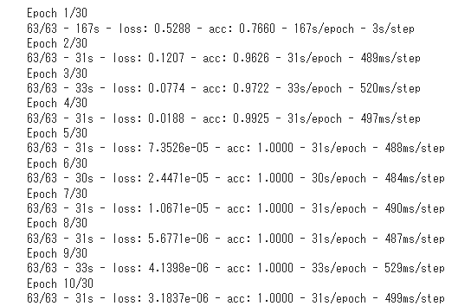
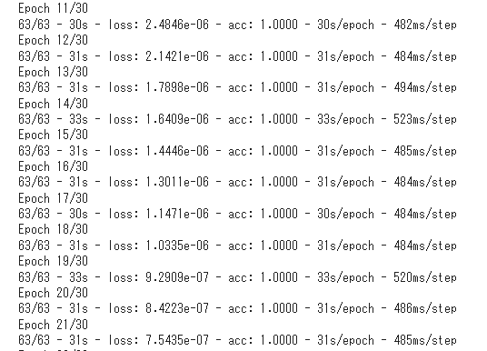
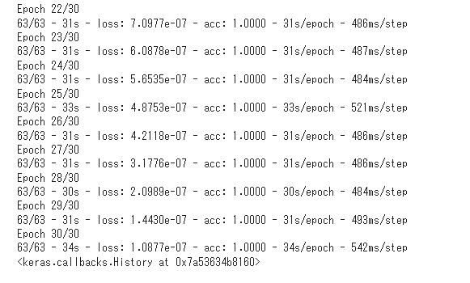
Modeling using CNN
Target Size: 50, 100
Epochs: 30, Batch_Size: 10
Number of Classes :
Angelina Jolie : 0
Nu Nu Hlaing : 1
Will Smith : 2
Found 936 images belonging to 3 classes.
Found 234 images belonging to 3 classes.

Slide 16
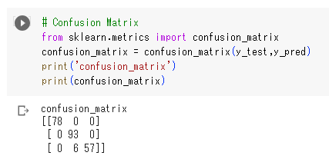
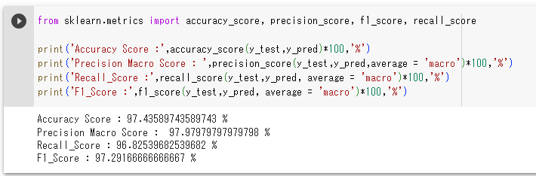
Evaluation

Slide 17
Saving In/Out Time in CSV
After the trained model predicts the name,
SA saves date, and time to the CSV file corresponding predicted name, called DatasetInfo.csv
Within this CSV file, each row holds the predicted name, the current date, the current time, and additional details.
Whenever someone is predicted to be present, their check-in/out date and time are added to dataset csv.
At the conclusion of each day, the system compiles all the gathered information and organizes it within a distinct file named "DailyAttendance_yyyymmdd.csv".
This method ensures that the data for each day is segregated and stored systematically.

Slide 18
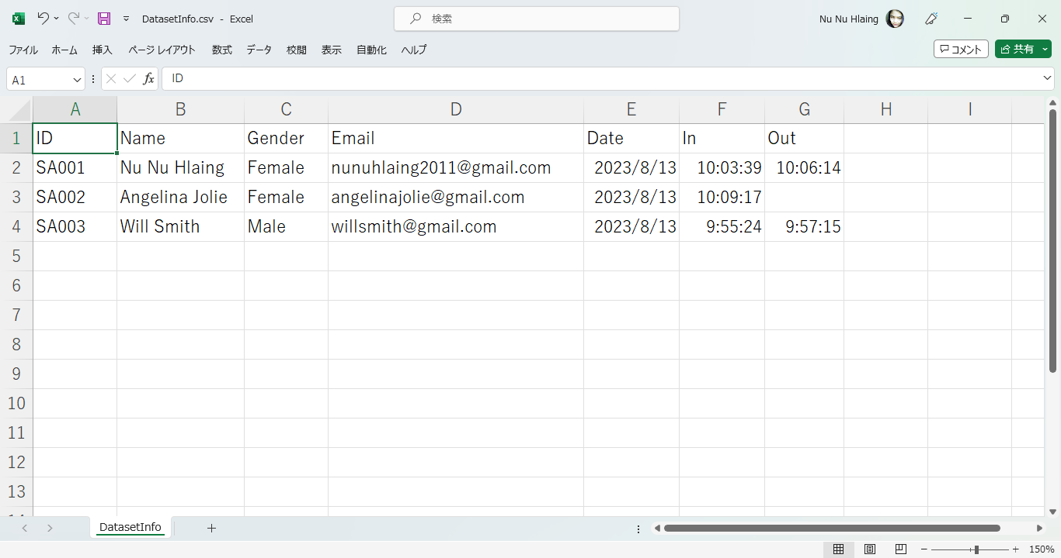
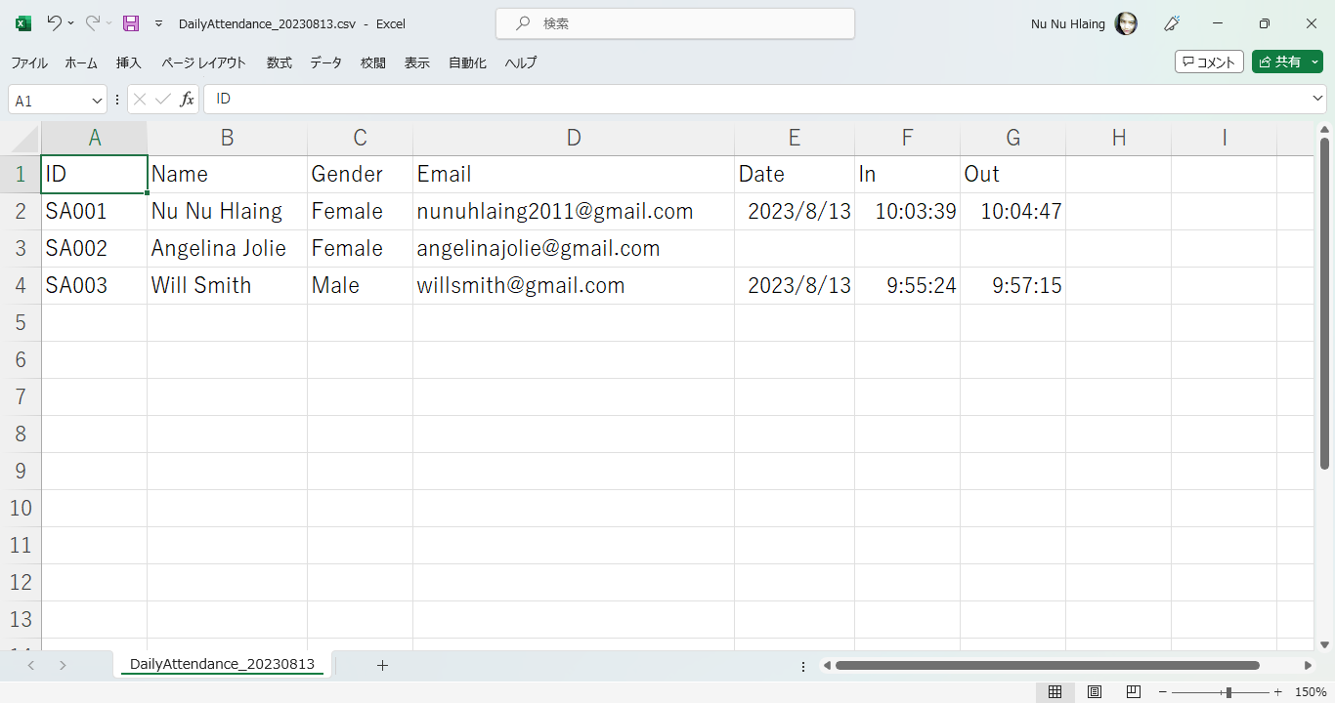
Saving In/Out Time in CSV
DailyAttendance_yyyymmdd.csv
DatasetInfo.csv

Slide 19
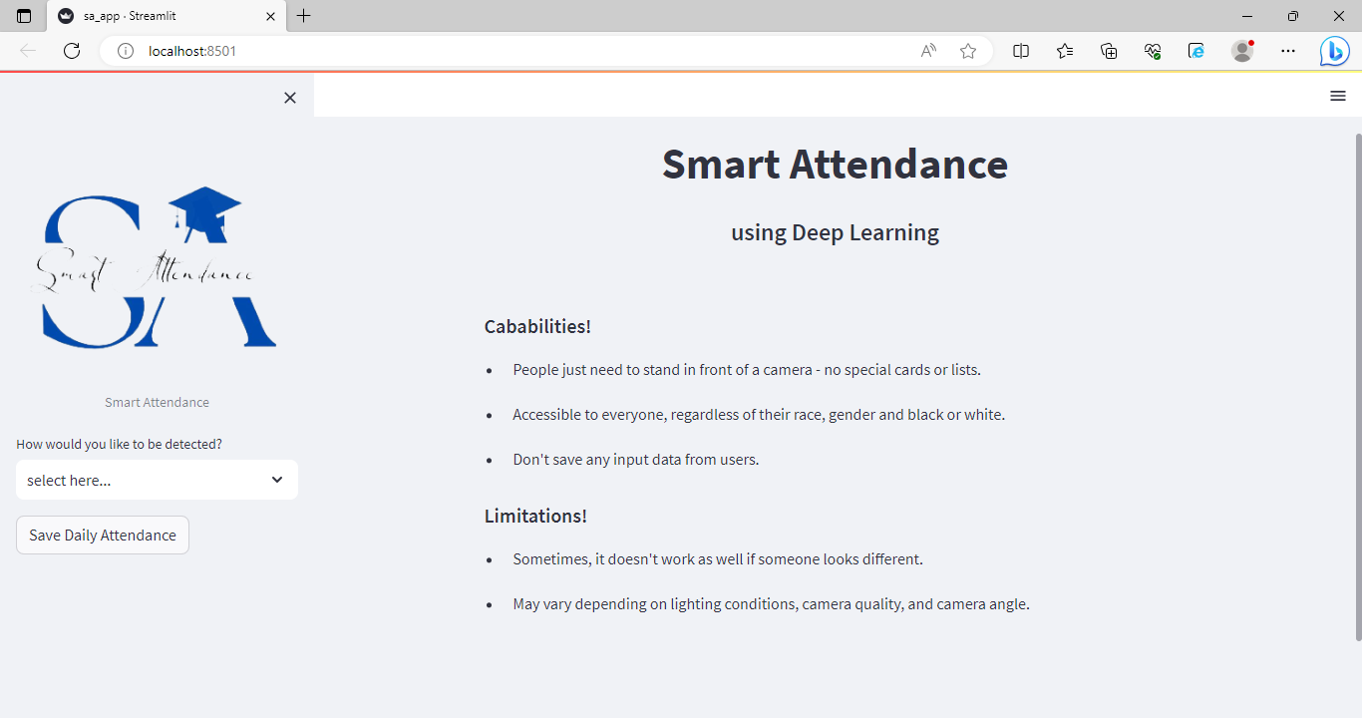
User Interface
SA develops user interface using Streamlit
Title and Description
Capabilities and Limitations
Image Upload Section
Webcam Feed
Face Prediction Results
Daily Attendance CSV File
Contact Us

Slide 20
AI Ethics
Privacy & Security
Explainability
・Don’t save any input data from users
・ Avoid deploying the system where it could be used for unethical purposes
・ Easy to use with user-centric design
・People just need to stand in front of a camera
- no special cards or lists.
Limitations
Fairness
・ Treat everyone fairly and equally without any bias based on factors like race, gender, or background
・Sometimes, it doesn't work as well if someone looks different.
・ May vary depending on lighting conditions, camera quality, and camera angle

Slide 21
Future Work
Due to lack of time and resources we conclude at an intermediate state of this work.
Whoever wishes to proceed further can take these points!
Model optimization : To extend the model to be more culturally sensitive and adaptable. Train model with unique ID rather than Name. Dataset expansion : To expand and diversify the dataset to ensure it represents a wide range of people. Data augmentation: To improve performance in challenging environments, such as varying lighting conditions, pose variations that can impact accurate face recognition
Real-time Performance :
To optimize the model for real-time processing to provide immediate updates without delay.

Slide 22
LIVE DEMO
https://github.com/NuNuHlaing/Smart-Attendance

Slide 23
Q & A

Slide 24
References
Face Recognition: https://github.com/juan-csv/face-recognition
Haar Cascade: https://github.com/opencv/opencv/tree/master/data/haarcascades
Dataset from Kaggle
Open Source Libraires, ChatGPT

Slide 25
THANK YOU!

